Slide 1
Power
14-1

Slide 2
Lesson Objectives
I can describe the factors that affect power.
I can explain ways to increase or decrease power.
I can describe how work and power are related.

Slide 3
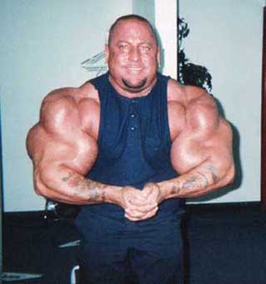
What is “Power”?
I am here to pump you sissy's up!
We like to think of Power
as how strong someone is
But in science we use
“power” to say how long it
takes to do a certain
amount of work

Slide 4
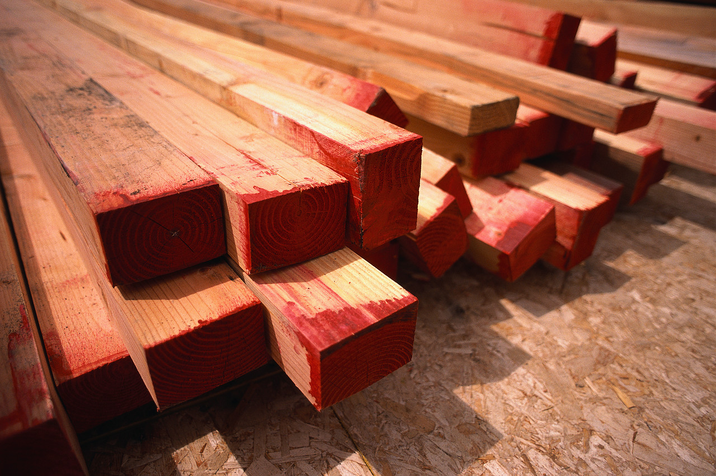
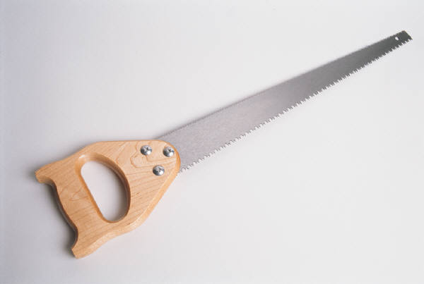
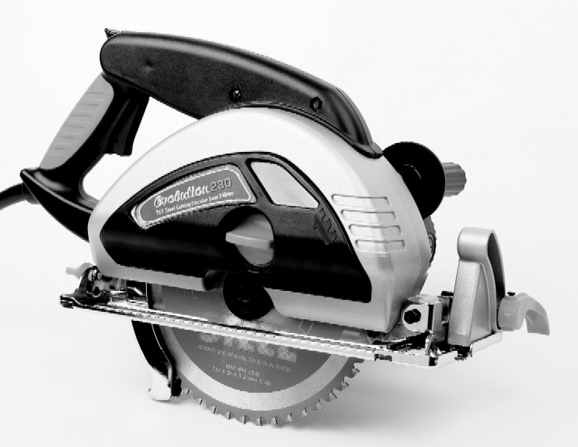
More or Less Power?
Main Idea/Big Idea: Power is ONLY about how fast work gets done!
It’s nice to get work done quickly!
So here we have a certain amount of stacked wood. We need to cut it!
We have several choices of tools we can use:
“Power Saw”
This saw will get the work
done eventually, but it takes
way too long to do it
Since this saw does the same
work faster than the hand
saw, we say it
has MORE POWER!!!
OR
Hand Saw
Here’s the point:
Both will get the same work done (cutting all the boards),
but one will take less time = more power!!!

Slide 5
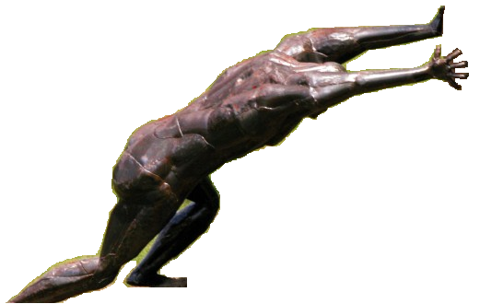
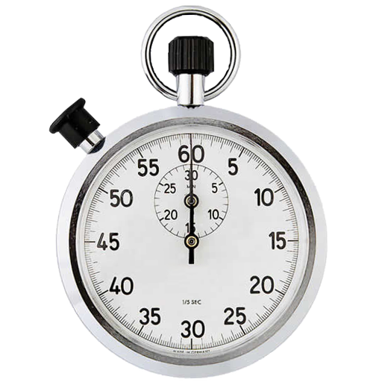
Power
Gee … Isn’t he
just mighty powerful?
Ungh!
Need… more… POWER!
Once work is calculated, we simply see how much time we actually moved someone/something. Once we find our unit rate of how much work we did in 1 second, we’ve found out how much “Power” we exerted.
Force
(Push)
Time [s]
Distance

Slide 6
Formula for Power
Power is measured in a unit called “Watts”

Slide 7
Calculating Power
Power = work divided by time
P = $\frac{W}{T}$
Power is the rate at which work is done.
joules
Watts
seconds

Slide 8
2 Ways to increase power
Increase the amount of work in a given amount of time.
Given amount of work in less time.

Slide 9
2 factors that affect power
Work
Time

Slide 10
Big Ideas
Power is the rate at which work is done.
2 ways to increase power are:
increase the amount of work in a given time
given amount of work in less time.
The two factors that affect the power are:
Work
Time

